Slide 1

WRCCDC - 2019
Ankur Chowdhary (achaud16@asu.edu)

Slide 2
What is CCDC ?
What you will do when you actually get attacked by some professional hackers?
How will you ensure your customers don’t lose their business?
Can you tell your boss why this attack happened in the first place, and how you ensured it won’t happen again?
Can you work/coordinate as a team to protect your Company or Government Organization?
Largest college level cyber defense competition.
Focused on managing and protecting cyber infrastructure.
Most competitions are focused on offensive aspect of cybersecurity, limited for defense.
CCDC gives a unique opportunity to learn and respond to actual cyber attack.

Slide 3
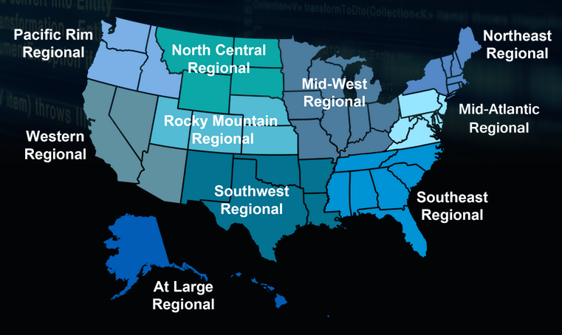
NCCDC

Slide 4

WRCCDC

Slide 5
Timeline
Stage 1: Invitationals (Virtual)
Sept 1 - Registration for Invitationals
Oct 1 - Invitational 1
November 3 - Invitational 2
December 3 - Invitational 3
December 16 - Team Roster Due (12 max, 2 grad students) - 8 will play
Stage 2 - Qualifiers (Virtual)
Jan 28 - Qualifiers ( 8 out of 17-20 teams go to next round)
Jan 31 - Student Resumes due
Stage 3 - Regionals (In-Person)
Final Team roster due
March 24-26 - Cal Poly Pomona

Slide 6
Composition
White Team - Hands out business injects
Black Team - Sets up your network infrastructure
Red Team - Attempts to penetrate your network
Blue Team - Us (8 playing members), 4 - reserved (no substitutions during competitions)
Orange Team - Customer who calls to check service status
Gold Team - They are organizers, they send emails for logistics, conference calls to answer questions on rules, etc.

Slide 7
Roles and Responsibilities
Windows Admin - 2003, XP, 2010, 2016, 2012-Server ?
Linux Admin - Debian, Redhat, Arch Linux, Gentoo, Fedora, Ubuntu, Feratu ?
Inject Admin - ?
Firewall Admin 1&2 - ?
Incident Response Admin - ?
Log Analysis Admin - ?
Database, Webapp Security Admin - ?
Presentation and Orange Team Admin - ?

Slide 8
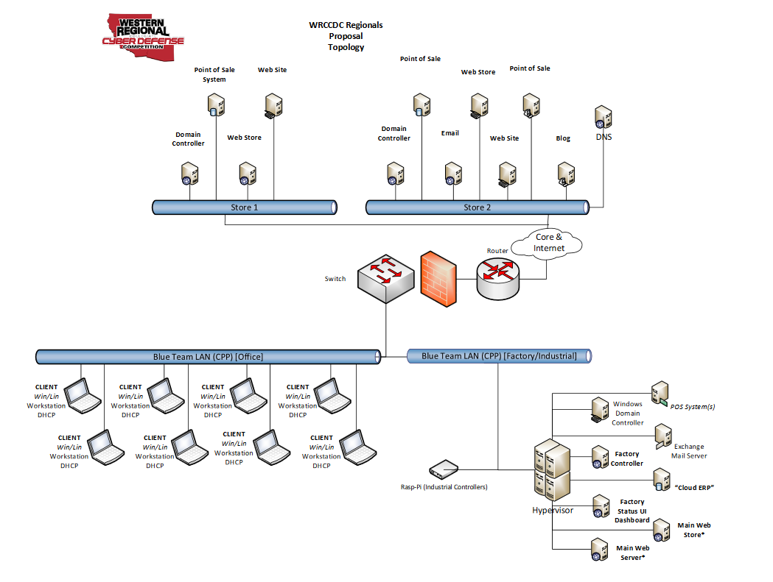
Environment
Qualifiers - 10 VMs - mix of Linux and Windows - 2,3 services on VMs, some VMs have no running services. Palo Alto Virtual Firewall.
Regionals - 8 physical machines, 20 virtual machines - 60% Linux, 40% Windows on VMWare esxi and other virtual infrastructure, Palo Alto Hardware Firewall, Cisco Switch.

Slide 9
WRCCDC - How we gain points ?
Critical Services: Services are checked for functionality and availability throughout the competition – you gain points each time one of your services is “up” or functioning properly when it is checked. Scoring Engine ticks every ~5-10 mins.
Injects: Each team needs to perform business tasks and submit reports. Tasks range from simple password policy to complex - set up Sendmail server and create users for access by Orange Team, install IIS Server, set up DNS subdomains for websites. (0%- no submissions, 10% - something submitted, 25% - incorrect, 50% - didn’t follow instructions, 75% - correct but incomplete, 100% - nailed it)
Incident Response: Submit a successful and detailed root cause analysis report with proof (logs) to showcase you detected incident, how it can be prevented in future - Firewall, IDS, service logs.
Presentations and Orange Team (customer support) - 4 different presenters need to present to a panel.

Slide 10
WRCCDC - How we lose points
Red Team activities- Service goes down due to attack or misconfiguration on our part, scoring engine deducts points. User level access costs fewer points than root level access on VM/services.
Failed to submit business injects on time or incomplete business injects
Bad incident reports.
Bad presentations and Orange team operations.
Black Team helps you to debug networking issues that you can’t figure out.
Team which scores best on Service Points, Inject Points, Incidence Response points wins.

Slide 11
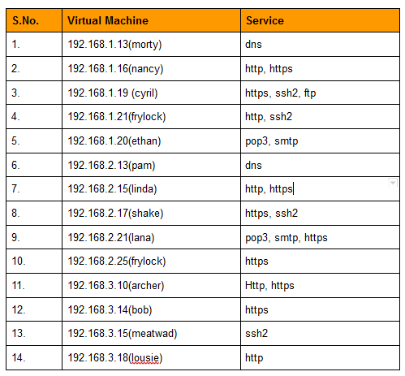
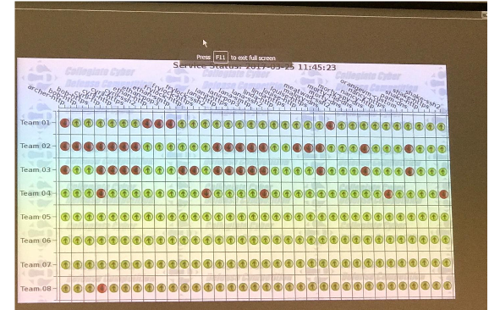
Critical Services

Slide 12
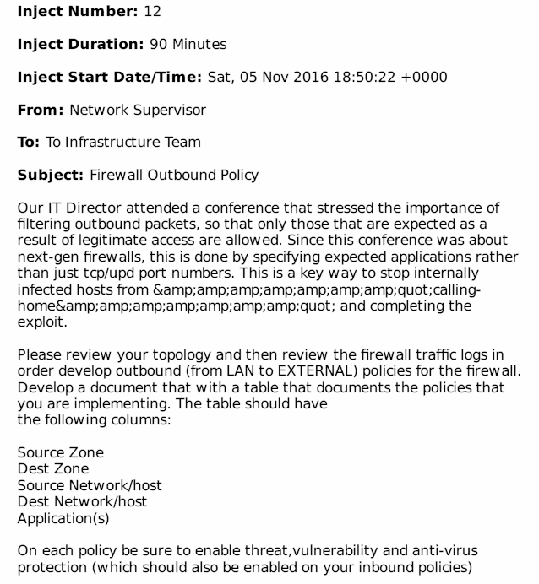
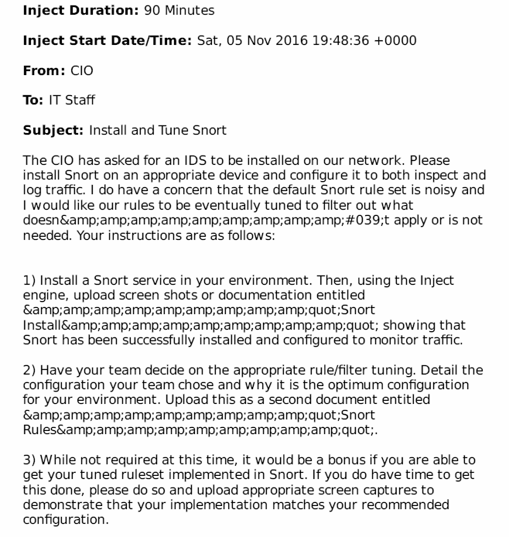
Business Injects

Slide 13
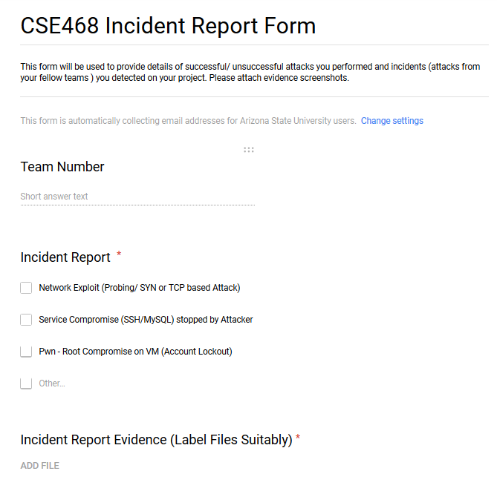
Incidence Response

Slide 14
Time Commitment
August-September 3-4 hours every week + meeting
October-December - 5-6 hours/week
Qualifier - January ~ 8-10 hours/week
Feb - March End ~ 8-10 hours/week

Slide 15
FAQs?
Can I compete if I graduate this semester?
Yes. If you are registered in current team, they allow you to compete this season.
I don’t have that much experience in Cybersecurity, will I be a good fit?
We have talked to competing team members from other schools with Biotech and Electrical Engg. majors, as long as you are dedicated you can be good fit.
When does Red Team starts to attack/ begin?
Same time as you login

Slide 16
FAQs?
What tools Red Team uses?
Cobalt Strike, metasploit, etc.
What is strength of Red Team?
Regionals have 15 members with ~5-10 years of industrial experience.
Can we initially shut ourselves from external network and bring services up once we have secured everything - take some penalty at beginning and be safer in long run ?
They know you will try that - scoring engine penalty is twice as high initially
How do I know we have been hacked and it’s not a misconfiguration?

Slide 17
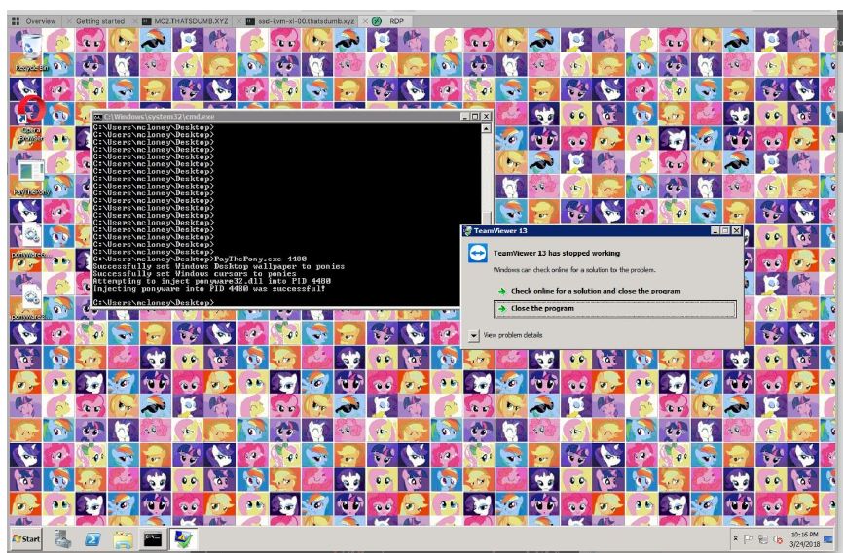
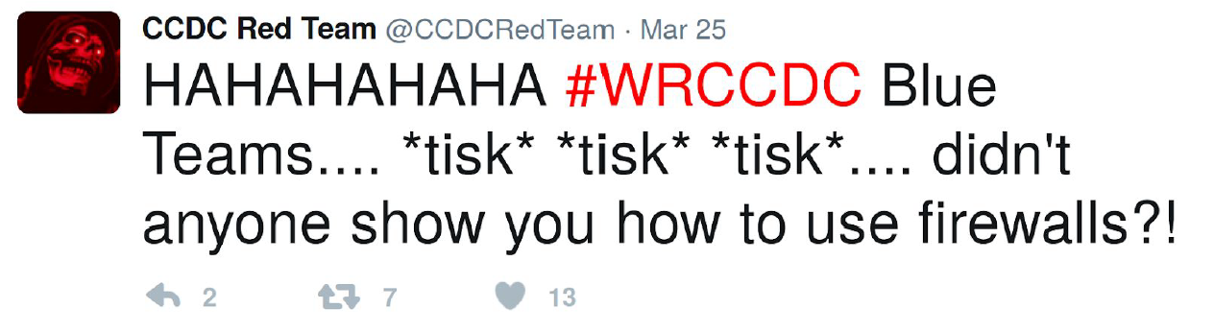
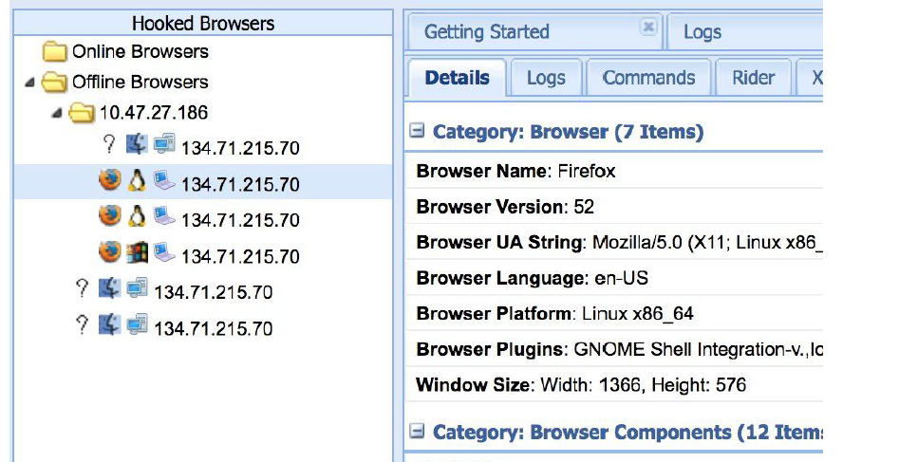
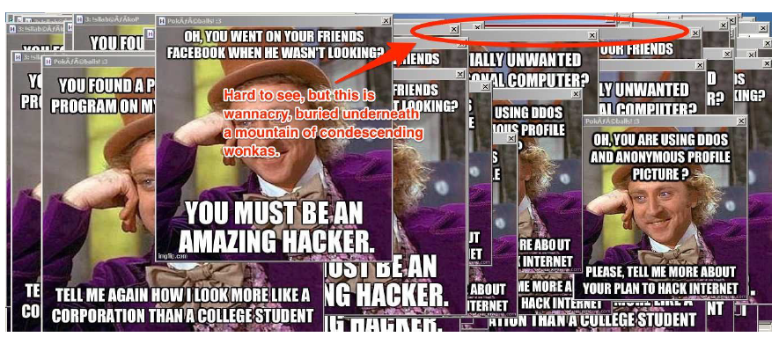
You will definitely know….!!!!

Slide 18
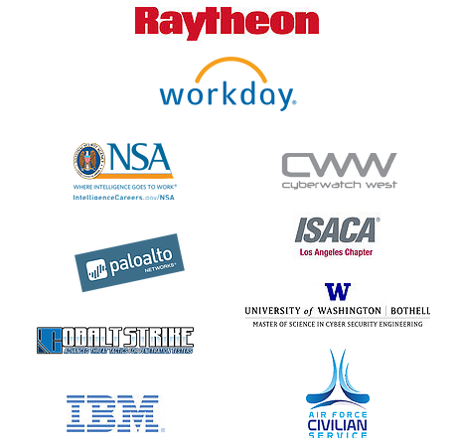
Perks
Chance to network with renowned industry professionals working as Red Team members, pen-testers in the Industry.
Chance to interact with recruiters for Cybersecurity positions.
Real world Blue teaming practice enhances your preparedness to respond to actual cyberattacks.
WRCCDC trip is sponsored by ASU Center for Cybersecurity and Digital Forensics (CDF).
Add CCDC experience to your Resume. Past team members found good positions in Cybersecurity Industry.

Slide 19
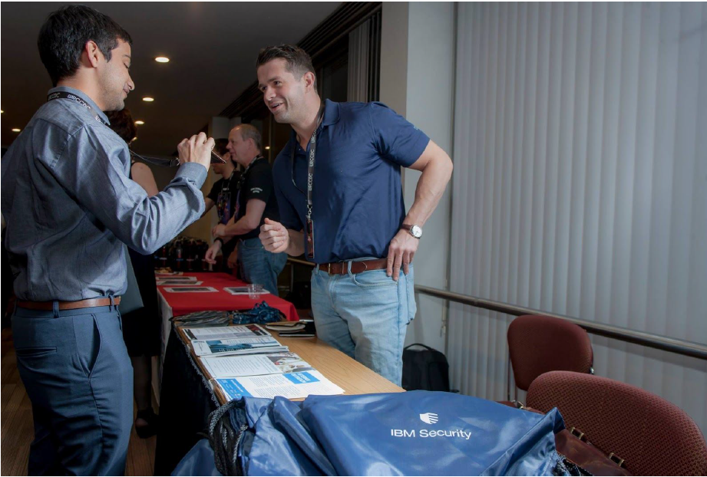
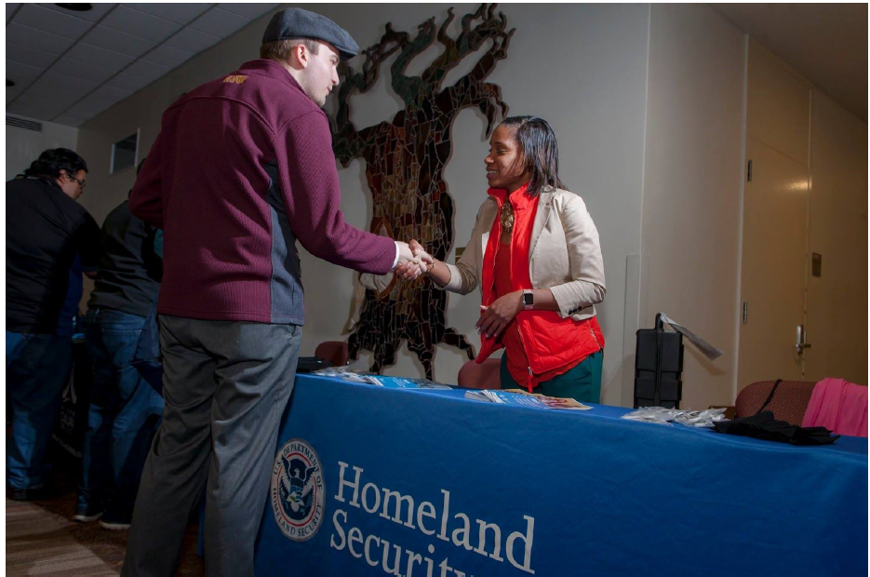
Perks

Slide 20
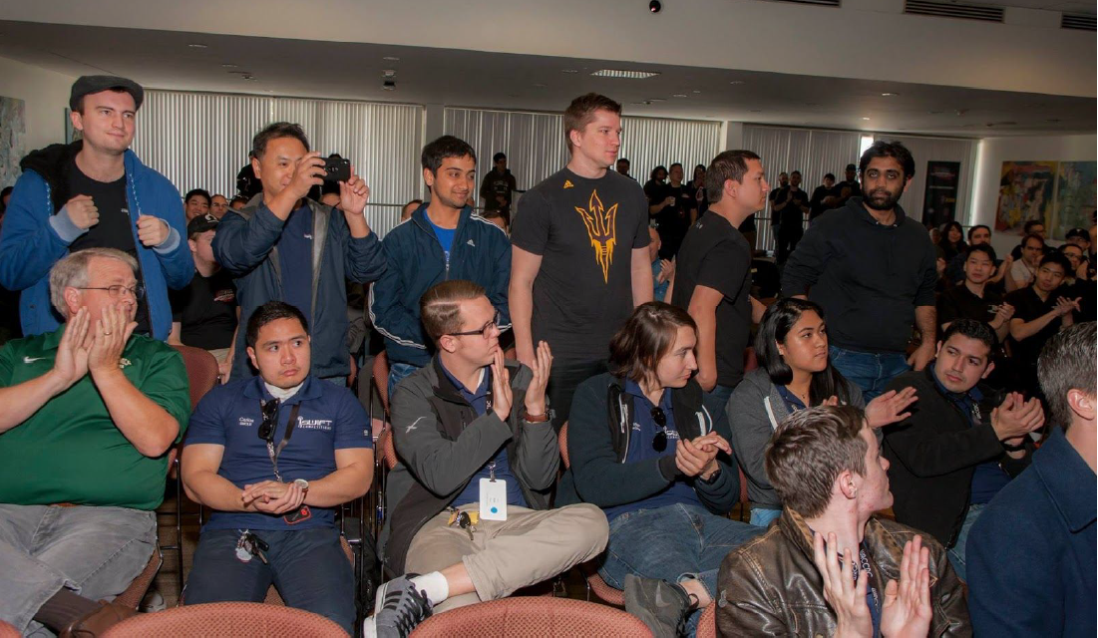
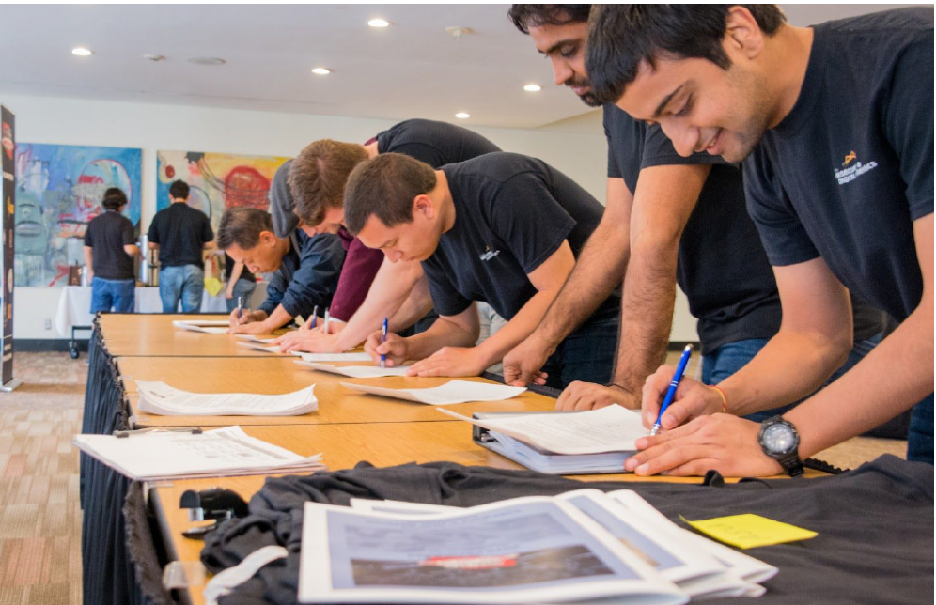
WRCCDC 2018 Team

Slide 21
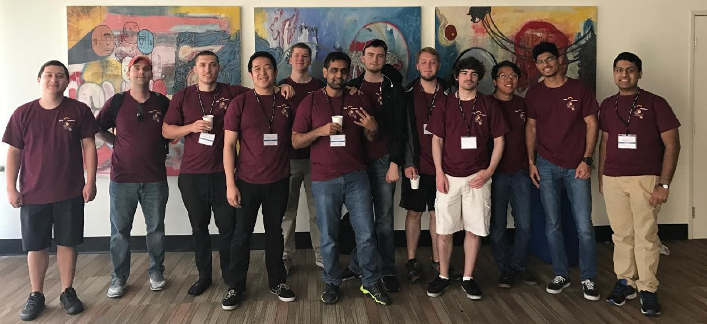
WRCCDC 2017 Team

Slide 22
WRCCDC ASU Alumni
2018 - Team
Vaibhav Dixit - Software Engineer (Comcast) - Grad
Chase Lybbert - Cybersecurity Analyst ( McKesson) - Undergrad
Jeffrey Moore - Security Engineer (McKesson) - Undergrad
Michael O’Loughlin - (UHaul Corporate) - Undergrad
Jacob Loden - Sr. Pen Tester (Honeywell) - Undergrad
2017 - Team
Tejas Khairnar - Security Engineer (Intuit) - Grad
Emanuel Boderash - Security Application Engineer (AMEX) - Undergrad
John Shaller - (Accenture) - Undergrad
Nicholas Ton - Network Consulting Engineer (Cisco) - Undergrad
Wil Gibbs - ASU Student, President: pwddevils - Undergrad
Ngoc Nguyen - ?
Daniel Martin - ?

Slide 23
Joining Requirements
Write me an email titled “WRCCDC 2019 - Team ASU”- achaud16@asu.edu. Let me know your background and expected graduation date. Resumes not required.
Meeting every Friday 4-5 pm in BYENG 210.
Create an account on ThothLab: https://www.thothlab.com/
Slack Channel : https://asu-ccdc.slack.com.
Last year team members will join us remotely at times to give you instructions on how to prepare.
Bring your laptop. Meeting times will be decided based on timings that suit for most participants, likely to be Thursday or Friday evenings.

Slide 24
References and Previous Documents
http://www.wrccdc.org/competition-overview
https://archive.wrccdc.org/
https://www.nationalccdc.org/
https://www.scribd.com/document/318192735/wrccdc-security-policy
http://nccdc.org/files/CCDCteamprepguide.pdf
https://en.wikipedia.org/wiki/National_Collegiate_Cyber_Defense_Competition

